Slide 1
Introduction to e-business and
e-commerce

Slide 2
Introduction
Part 1
Introduces e-business and e-commerce and their relevance to businesses and consumers. It clarifies e-business terms and concepts such as online business, revenue and technology models by reviewing alternative applications through activities and case studies.

Slide 3
Introduction to e-business and e-commerce
The impact of the electronic communications on traditional businesses.
What is the difference between e-commerce and e-business?
E-business opportunities.
Business adoption of digital technologies for e-commerce and e-business.
E-business risks and barriers to business adoption.
Management responses to e-commerce and e-business.

Slide 4
Learning outcomes
Define the meaning and scope of e-business and e-commerce and their different elements
Summarize the main reasons for adoption of e-commerce and e-business and barriers that may restrict adoption
Outline the ongoing business challenges of managing e-business and e-commerce in an organization.

Slide 5
Management issues
How do we explain the scope and implications of e-business and e-commerce to staff?
What is the full range of benefits of introducing e-business and what are the risks?
How do we evaluate our current e-business capabilities?

Slide 6
Introduction
Organizations have now been applying technologies based on the Internet, World Wide Web and wireless communications to transform their businesses for over 15 years since the creation of the first web site (http://info.cern.ch) by Sir Tim Berners-Lee in 1991.
Deploying these technologies has offered many opportunities for innovative e-businesses to be created based on new approaches to business.
Table 1.1 highlights some of the best-known examples and in Activity 1.1 you can explore some of the reasons for success of these e-businesses.

Slide 7
Table 1.1
Year Company / site Category of innovation and business model Founded:
1994 Amazon Retailer.
1995 (March) Yahoo! (yahoo.com) Directory and portal.
1995 (Sept) eBay Online auction.
1995 (Dec) AltaVista (altavista.com) Search engine.
1996 Hotmail (hotmail.com) Web-based e-mail,Viral marketing (using e-mail signatures to promote service),Purchased by Microsoft in 1997.
1998 GoTo.com (goto.com) Pay-per-click search marketing.
Overture (2001) Purchased by Yahoo! in 2003.
1998 Google (google.com) Search engine.
1999 Blogger (blogger.com) Blog publishing platform Purchased by Google in 2003.
1999 Alibaba (alibaba.com) B2B marketplace with $1.7 billion IPO on Hong Kong stock exchange in 2007. See case in Chapter 2.

Slide 8
1999 MySpace (myspace.com) Social network.
Formerly eUniverse Purchased by News Corp in 2005.
2001 Wikipedia (wikipedia.com) Open encyclopedia.
2002 Last.fm A UK-based Internet radio and music community web site,founded in 2002. On 30 May 2007, CBS Interactive acquired Last.fm for £140m (US$280m).
2003 Skype (skype.com) Peer-to-peer Internet telephony VoIP – Voice over Internet protocol.
Purchased by eBay in 2005, 2003.
Second Life (secondlife.com) Immersive virtual world.
2004 Facebook (facebook.com) Social network applications and groups.
2005 YouTube (youtube.com) Video sharing and rating
2007 Joost (joost.com) Quality video broadcast service.
IPTV – Internet Protocol TV.
?? The future ??

Slide 9
Continue
For the author, e-business and e-commerce is an exciting area to be involved with, since many new opportunities and challenges arise yearly, monthly and even daily. Innovation is a given, with the continuous introduction of new technologies, new business models and new communications approaches.
For example, Google innovates relentlessly. Its service has developed a long way since 1998 (Figure 1.1) with billions of pages now indexed and other services such as web mail, pay per click adverts, analytics and social networks all part of its offering. Complete Activity 1.1 or view Table 1.1 to see other examples of the rate at which new innovations occur.

Slide 10
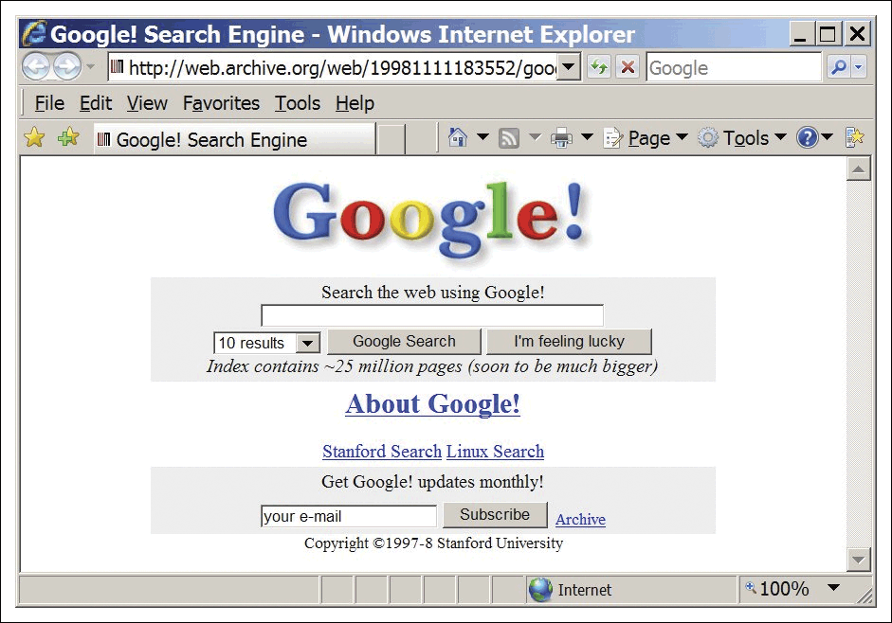
Figure 1.1 Google circa 1998
Source: Wayback machine archive: http://web.archive.org/web/19981111183552/google.stanford.edu

Slide 11
E-business innovation and opportunity
Since Google was launched in 1998 which
e-business start-ups have transformed the way we work, live and play?
How has Google innovated in search and its business table?
See Table 1.1 for some of major innovators

Slide 12
The impact of the Internet on business
Andy Grove, Chairman of Intel, one of the early adopters of e-commerce, has made a meteorological analogy with the Internet. He says:
Is the Internet a typhoon force, a ten times force, or is it a bit of wind? Or is it a force that fundamentally alters our business? (Grove, 1996)

Slide 13
E-business opportunities
Reach
  Over 1 billion users globally
  Connect to millions of products
Richness
  Detailed product information on 20 billion + pages indexed by Google. Blogs, videos, feeds…
  Personalized messages for users
Affiliation
  Partnerships are key in the networked economy

Slide 14
Internet risks – what can go wrong with a transactional site?
1.False orders made by customers
2. Incorrectly input orders
3. Insufficient security
4. People are usually hesitant to give out banking details over the internet
5. After sales service may be hard to organize depending on store location and postage
ما الذي يمكن أن يحدث خطأ في موقع المعاملات؟
• أوامر كاذبة من قبل العملاء
• أوامر إدخالها بشكل غير صحيح
• عدم كفاية الأمن
• الناس عادة ما يترددون في إعطاء تفاصيل مصرفية عبر الإنترنت
• خدمة ما بعد البيع قد يكون من الصعب تنظيم اعتمادا على موقع مخزن والبريد
Notes:
This slide left deliberately blank for student Q&A interaction.
Potential answers:
Site downtime affecting whole site or some processes
Security attack, e.g. denial of service, content hijacked
Wrong content presented for site visitor

Slide 15
What is e-commerce and e-business?
You are attending a role in the e-business team of a global bank You anticipate you may be asked the distinction between
e-commerce and e-business.
E-commerce: Electronic commerce (e-commerce)
All electronically mediated information exchanges between an organization and its external stakeholders Kalakota and Whinston (1997) refer to a range of different perspectives for
e-commerce:
1 A communications perspective – the delivery of information,
products or services or payment by electronic means.
2 A business process perspective – the application of technology
towards the automation of business transactions and work-flows.
3 A service perspective – enabling cost cutting at the same time
as increasing the speed and quality of service delivery.
4 An online perspective – the buying and selling of products and
information online.

Slide 16
E-business:
Electronic business (e-business)
All electronically mediated information exchanges, both within an organization and with external stakeholders supporting the range of business processes.

Slide 17
Buy-side e-commerce and Sell-side e-commerce
Buy-side e-commerce
E-commerce transactions between a purchasing organization and its suppliers.
Sell-side e-commerce
E-commerce transactions between a supplier organization and its customers.

Slide 18
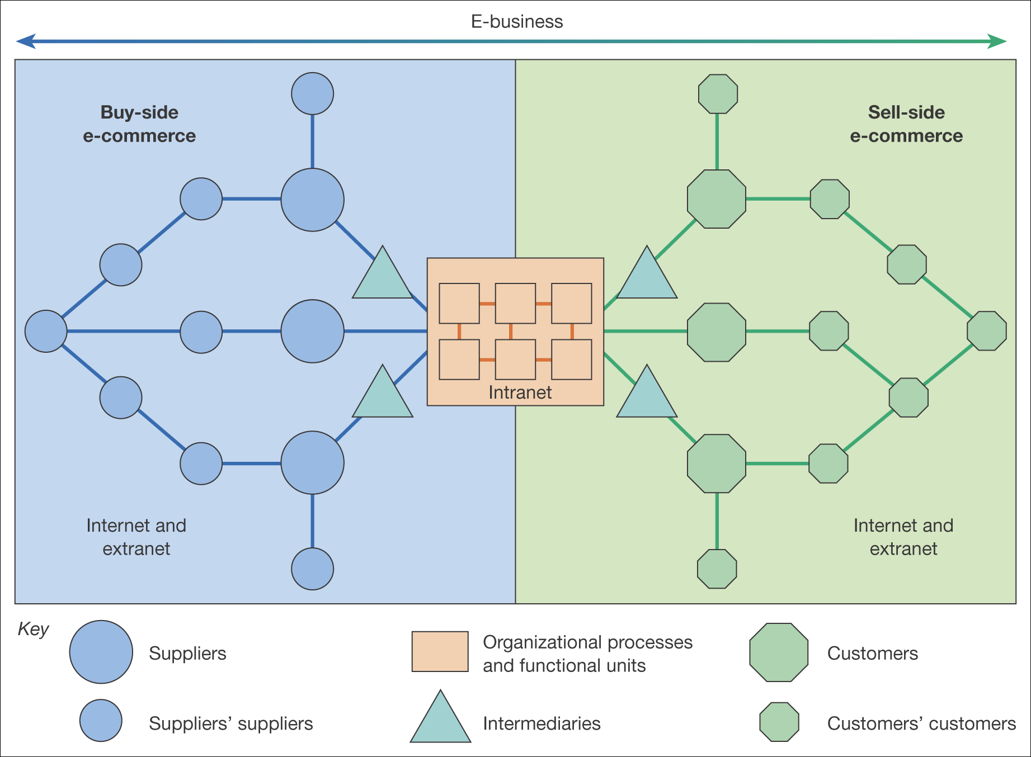
Figure 1.2 The distinction between buy-side and sell-side e-commerce

Slide 19
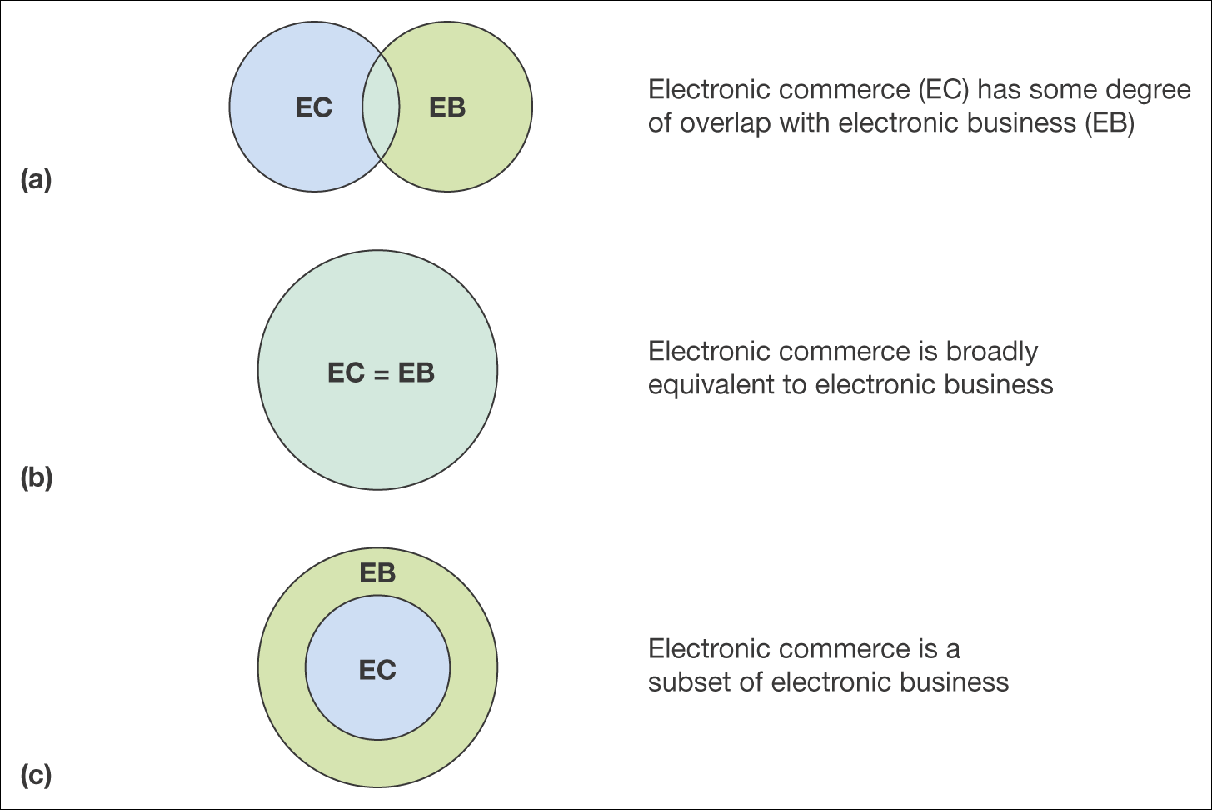
Figure 1.3 Three definitions of the relationship between e-commerce and e-business

Slide 20
In Figure 1.3(a) there is a relatively small overlap between
e-commerce and e-business.
From Figure 1.2 we can reject Figure 1.3(a) since the overlap between buy-side and sell-side e-commerce is significant.
Figure 1.3(b) seems to be more realistic, and indeed many commentators seem to consider e-business and e-commerce to be synonymous.
It can be argued, however, that Figure 1.3(c) is most realistic since e-commerce does not refer to many of the transactions within a business, such as processing a purchasing order, that are part of e-business.
So e-commerce can best be conceived of as a subset of e-business and this is the perspective we will use in this book.
Since the interpretation in Figure 1.3(b) is equally valid, what is important within any given company is that managers involved with the implementation of e-commerce or e-business are agreed on the scope of what they are trying to achieve!.

Slide 21
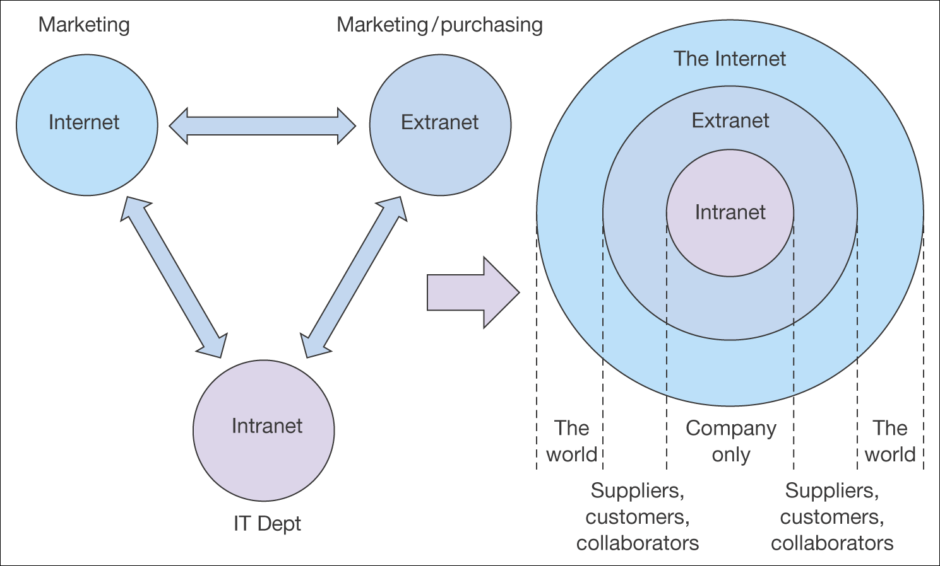
Figure 1.4 The relationship between intranets, extranets and the Internet

Slide 22
Intranet and Extranet
Intranet :
A private network within a single company using Internet standards to enable employees to access and share information using web publishing technology.
Extranet :
A service provided through Internet and web technology delivered by extending an intranet beyond a company to customers, suppliers and collaborators.

Slide 23
If information is restricted to employees inside an organization, this is an intranet as is shown in Figure 1.4.
In a survey of 275 managers responsible for an intranet featured in CIO (2002),
The main benefits mentioned by managers were:
1. Improved information sharing (customer service), 97%
2. Enhanced communications and information sharing (communications), 95%
3. Increased consistency of information (customer service), 94%
4. Increased accuracy of information (customer service), 93%
5. Reduced or eliminated processing, 93%
6. Easier organizational publishing, 92%.
It is apparent that benefits focus on information delivery suggesting that management of information quality is a key to successful use of intranets.

Slide 24
As an example, an online bank can potentially use many of these technologies to communicate with its customers according to the customers’ preferences – some prefer to use the web, others mobile banking or SMS alerts, others wireless or interactive TV and others traditional channels.
Bank First Direct (www.firstdirect.com) which is part of the HSBC banking group has a strategy of innovation and showcases its latest approaches in First Direct Interactive (Figure 1.5).
It uses SMS short codes as direct response from TV or print advertising to integrate traditional and digital media channels and also uses SMS periodically to deliver relevant related product offers to customers.

Slide 25
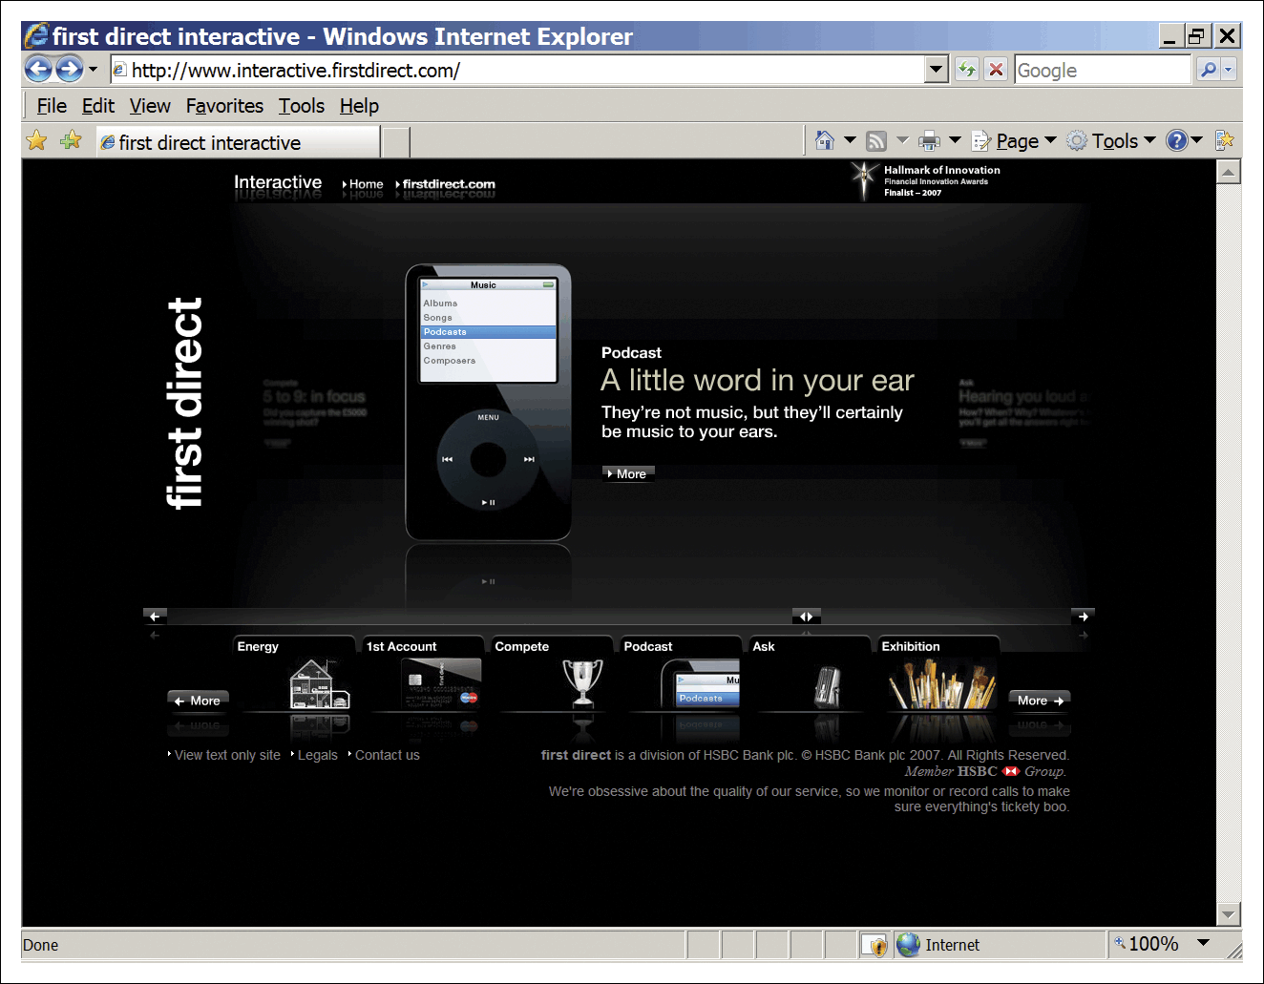
Figure 1.5 First Direct Interactive (www.firstdirect.com)

Slide 26
Mini Case Study 1.1 gives an example of a viral campaign which helped sell products
This example shows how an engaging idea can be discussed initially online and then in traditional media to help increase the awareness of a brand.
On the WillItBlend campaign micro-site (www.willitblend.com, Figure1.6) a blender designed for making smoothies has blended an iPhone, an iPod, golf balls, glow sticks and a video camera and more.

Slide 27
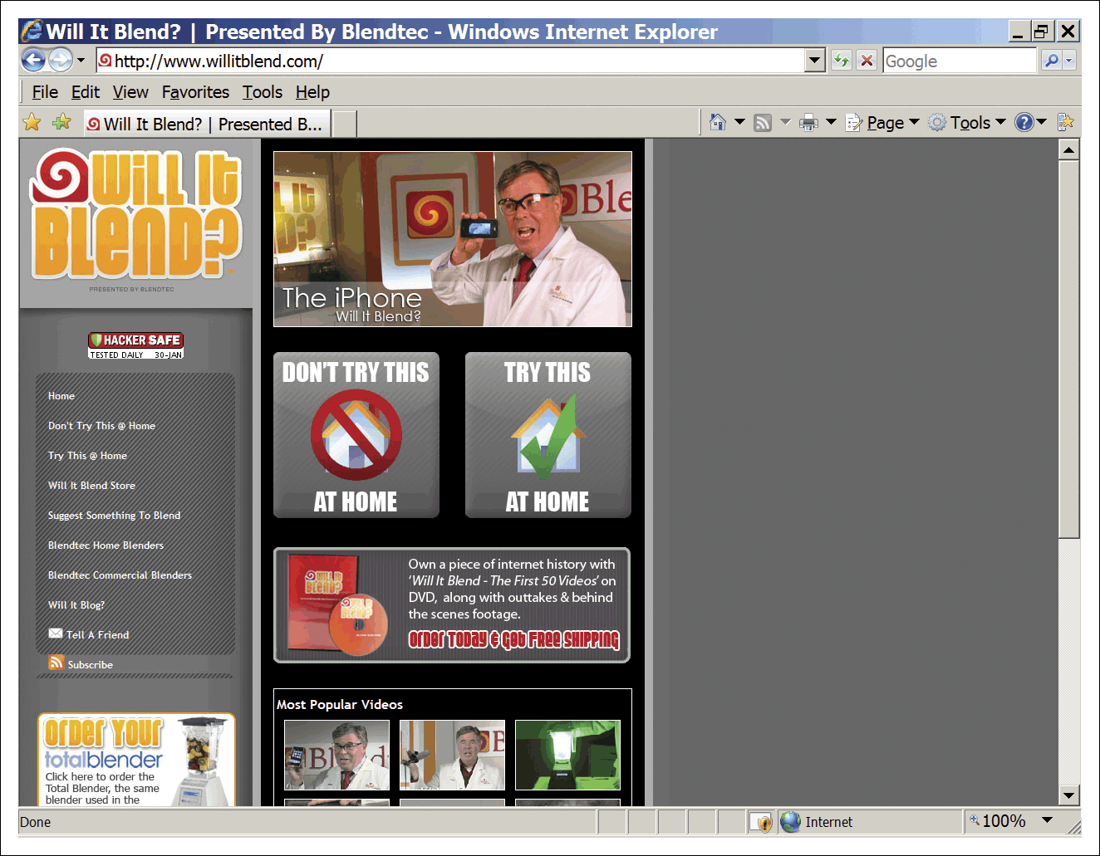
Figure 1.6 Blendtec viral campaign micro-site (www.willitblend.com)

Slide 28
Figure 1.7 summarizes the evolution of digital and web-related technologies
Since the Web 2.0 concept has been widely applied, it is natural that commentators would try to evolve the concept to Web 3.0, although the term hasn’t been widely applied to date. We can suggest that as web functionality evolves, these approaches which could be deemed ‘Web 3.0’ will become more important:
1.Web applications. Usage of web-based applications and services (like Google word processor and spreadsheets) using the web in this way is sometimes termed ‘cloud computing’ where all that is really needed for many activities is a computer with a web browser, with local software applications used less widely.
2. Syndication. Increased incorporation of syndicated content and services from other sites or a network into a site (using tools such as Yahoo! Pipes and XML exchange between widgets).

Slide 29
continue
3.Streamed video or IPTV. Increased use of streamed video from existing TV providers and user-generated content (as suggested by use of YouTube and IPTV services such as Joost);
4. Virtual worlds. Increased use of immersive virtual environments such as Second Life;
5. Personal data integration. Increased exchange of data between social networks fulfilling different needs (as indicated by the recent Google development of OpenSocial);
6. The semantic web. Increased use of semantic markup leading to the semantic web envisioned by Tim Berners-Lee over 10 years ago.

Slide 30
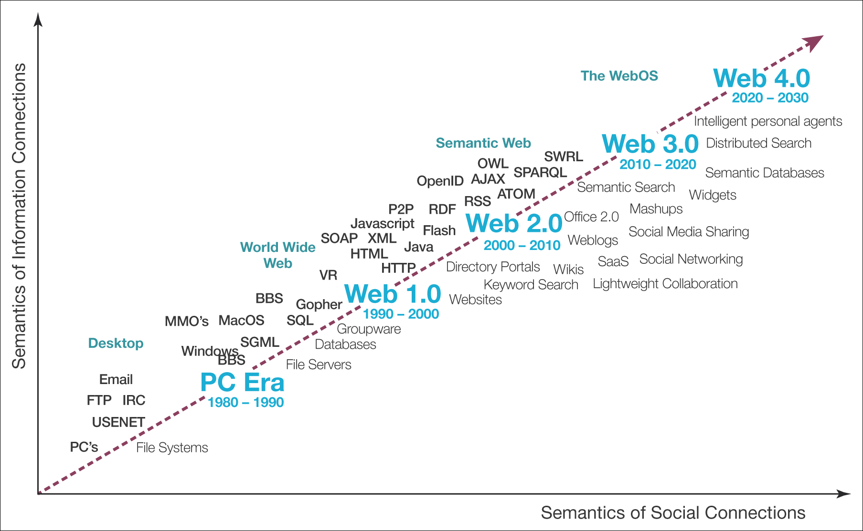
Figure 1.7 Evolution of web technologies
Source: Adapted from Spivack (2007)

Slide 31
Figure 1.8 Summary and examples of transaction alternatives between businesses, consumers and governmental organizations
It is now commonplace to describe e-commerce transactions between an organization and its stakeholders according to whether they are primarily with consumers (business-to consumer– B2C) or other businesses (business-to-business – B2B).
Figure 1.8 gives examples of different companies operating in the business-to-consumer (B2C) and business-to-business (B2B) spheres.
Often companies such as BP or Dell Computer will have products that appeal to both consumers and businesses, so will have different parts of their site to appeal to these audiences.
Figure 1.8 also presents two additional types of transaction, those where consumers transact directly with other consumers (C2C) and where they initiate trading with companies(C2B).
Finally, the diagram also includes government and public services organizations which deliver online or e-government services.
As well as the models shown in Figure 1.8, it has also been suggested that employees should be considered as a separate type of consumer through the use of intranets which are referred to as employee-to-employee or (E2E).

Slide 32
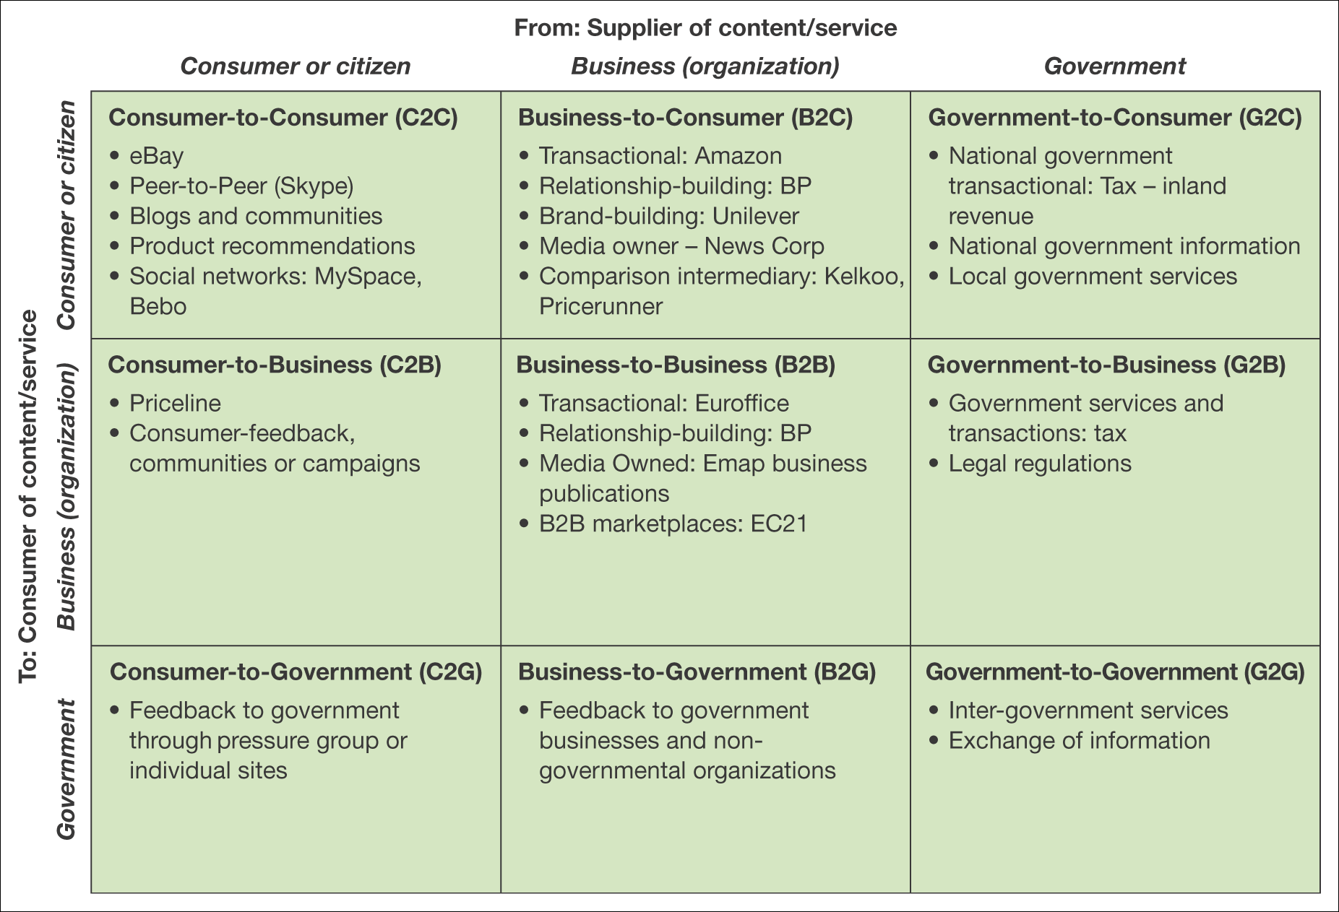
Figure 1.8 Summary and examples of transaction alternatives between businesses, consumers and governmental organizations

Slide 33
Additional activity – drivers and barriers to adoption
You are in a team of advisers at a local business link (a local government agency encouraging adoption of e-commerce)
List
  Drivers to adoption of sell-side e-commerce by business and how you can reinforce these by marketing benefits
  Barriers to adoption of sell-side e-commerce by business and how you can reinforce these by stressing benefits

Slide 34
Cost/efficiency and competitiveness drivers
Cost/efficiency drivers
  Increasing speed with which supplies can be obtained
  Increasing speed with which goods can be dispatched
  Reduced sales and purchasing costs
  Reduced operating costs
Competitiveness drivers
  Customer demand
  Improving the range and quality of services offered
  Avoid losing market share to businesses already using e-commerce

Slide 35
Usage of different e-business services in European countries.
Examples of poor online customer experience which you will certainly be familiar with include:
Web sites that fail because of a spike in visitor traffic after a peak-hour TV advertising campaign.
Hackers penetrating the security of the system and stealing credit card details.
A company e-mails customers without receiving their permission, so annoying customers and potentially breaking privacy and data protection laws.
Problems with fulfilment of goods ordered online, meaning customer orders go missing or are delayed and the customer never returns.
E-mail customer-service enquiries from the web site don’t reach the right person and are ignored.
The perception of these risks may have limited adoption of e-business in many organizations which is suggested by the data in (Figure 1.10).

Slide 36
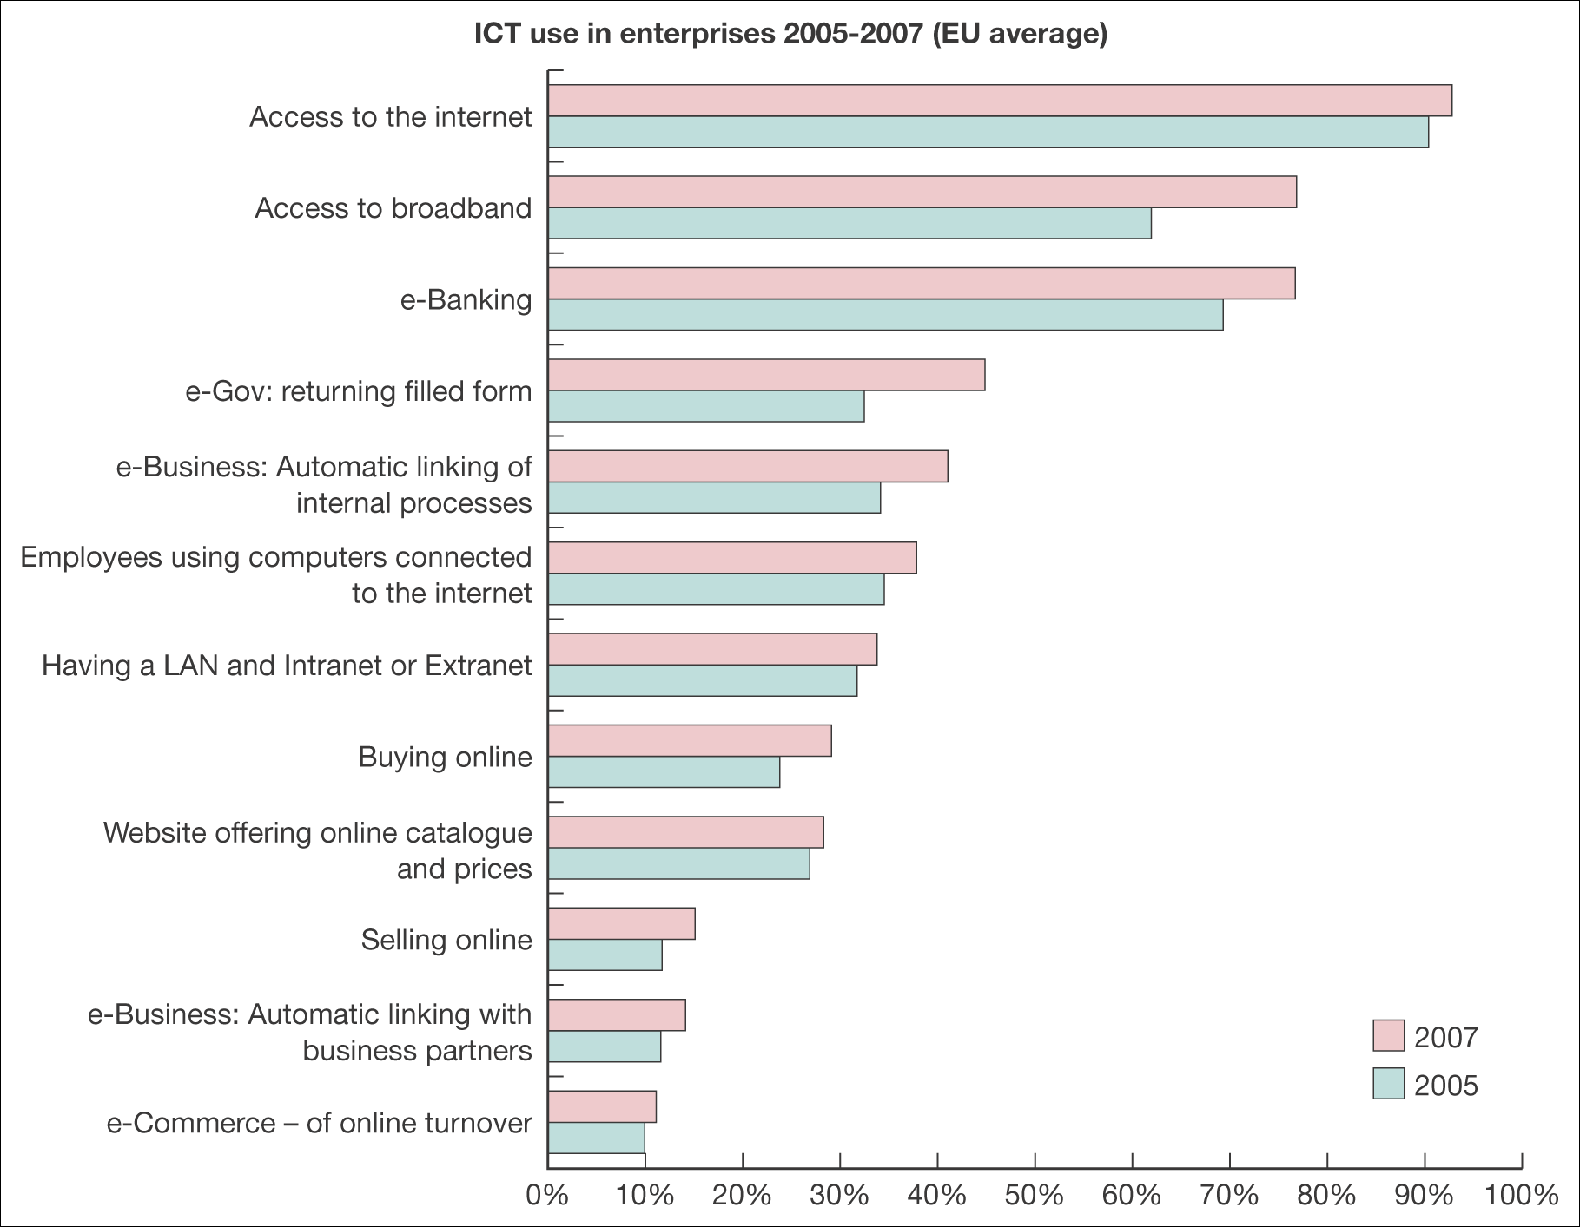
Figure 1.10 Usage of different e-business services in European countries
Source: European Commission, 2008

Slide 37
Barriers to development of online technologies
A DTI (2002) study evaluated some of the barriers to B2B e-commerce (Figure 1.12) which remain valid today.
You can see that reasons of cost were the most important factors.
This suggests the importance of managers assessing e-business to develop a cost–benefit analysis that considers both the initial investment costs and the ongoing costs that form the total cost of ownership (TCO) against the value created from the tangible and intangible benefits.

Slide 38
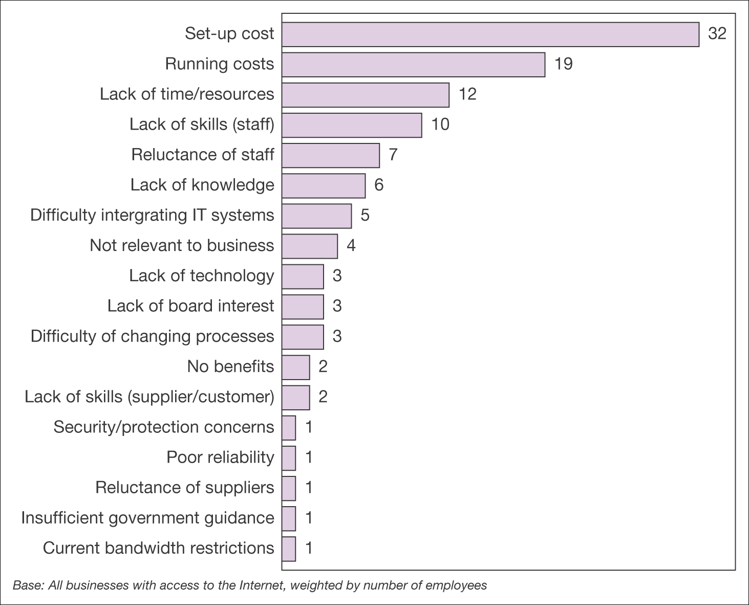
Figure 1.12 Barriers to development of online technologies
Source: DTI (2002)

Slide 39
A simple stage model for buy-side and sell-side e-commerce
An example of a basic stage model reviewing capabilities for sell-side and buy-side e-commerce is shown in (Figure 1.13) .This shows how companies will introduce more complex technologies and extend the range of processes which are e-business-enabled.

Slide 40
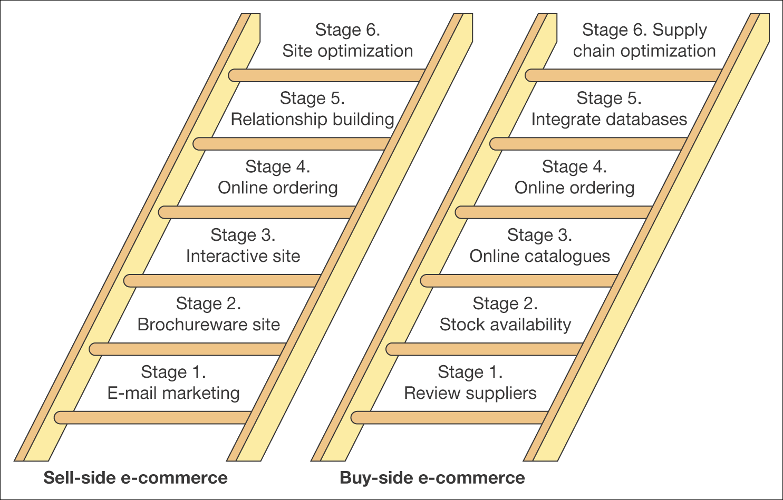
Figure 1.13 A simple stage model for buy-side and sell-side e-commerce

Slide 41
Variation in different online activities by gender
One example of demand analysis is popularity or adoption rates for different online services. The range of different ways in which consumers use the Internet to research or transact is shown in (Figure 1.14) .
You can see that male and female usage of the Internet for different activities is now very similar, but with downloading of different types of digital content generally more popular amongst males.

Slide 42
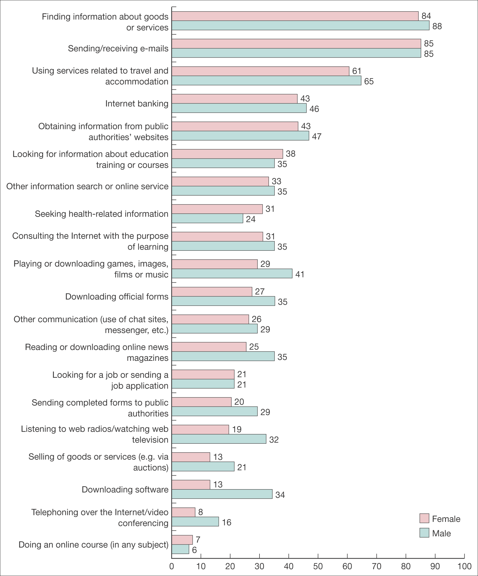
Figure 1.14 Variation in different online activities by gender
Source: UK National Statistics (2006) Individuals accessing the Internet – Report from the UK National Statistics Omnibus Survey. Published online at www.statistics.gov.uk

Slide 43
Typical benefits of online services are summarized by the ‘Six Cs’, a simple mnemonic(تذكري) to show different types of customer value
1. Content – In the mid-1990s it was often said that ‘content is king’. Well, relevant rich content is still king. This means more detailed, in-depth information to support the buying process for transactional or relationship-building sites or branded experiences to encourage product usage for FMCG brands.
2. Customization – In this case mass customization of content, whether received as web site pages such as ‘Amazon recommends’ or e-mail alerts, and commonly known as ‘personalization’.
3 Community – The Internet liberates consumers to discuss anything they wish through forums, chat-rooms and blog comments. We will explore these techniques more in Chapters 2 and 3.
4 Convenience – This is the ability to select, purchase and in some cases use products from your desktop at any time: the classic 24 × 7 × 365 availability of a service. Online usage of products is, of course, restricted to digital products such as music or other data services. Amazon has advertised off-line using creative showing a Christmas shopper battling against a gale-swept ( (عاصفة street clutching several bags to reinforce the convenience message.

Slide 44
5 Choice – The web gives a wider choice of products and suppliers than via conventional distribution channels. The success of online intermediaries such as Kelkoo (www.kelkoo.com) and Screen trade (www.screentrade.com) is evidence of this. Similarly, Tesco.com provides Tesco with a platform to give consumers a wider choice of products (financial, travel, white goods) with more detailed information than are physically available in-store.
6 Cost reduction – The Internet is widely perceived as a relatively low-cost place of purchase. Often customers expect to get a good deal online as they realize that online traders have a lower cost-base as they have lower staff and distribution costs than a retailer that runs a network of high-street stores. A simple price differential is a key approach to encouraging usage of online services. In the late 1990s, low-cost airline easy Jet encouraged the limited change behavior required from phone booking to online booking by offering a £2.50 discount on online flight bookings.

Slide 45
Barriers to consumer Internet adoption
An indication of some of the barriers to using the Internet, in particular for consumer purchases, is clear from a survey (Booz Allen Hamilton, 2002) of perceptions in different countries.
It noted that consumer barriers to adoption of the
Internet included:
No perceived benefit
Lack of trust
Security problems
Lack of skills
Cost.
This lack of demand for Internet services from this group needs to be taken into account when forecasting future demand

